Slide 1
CJM Algorithm Result

Slide 2
Overview
For each trial of the algorithm, a set of best representative CJMs is generated and the history of optimization is saved in a single CSV file;
Therefore, one execution of the algorithm with N trials produces N CSV files each contains the history of the specific optimization.

Slide 3
Distance Measure
Levenshtein distance:

Slide 4
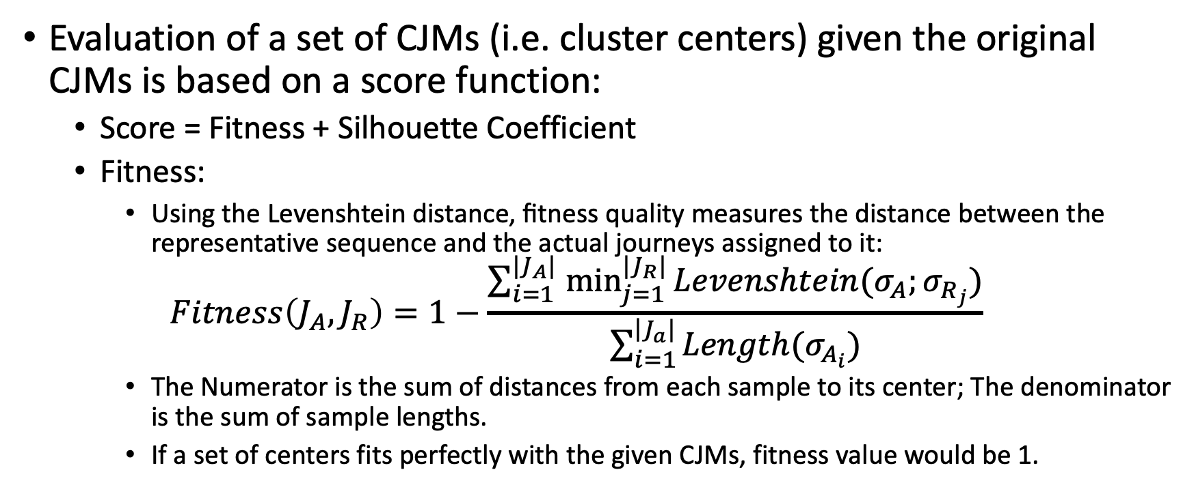
Evaluation Metric
Evaluation of a set of CJMs (i.e. cluster centers) given the original CJMs is based on a score function:
Score = Fitness + Silhouette Coefficient
Fitness:
Using the Levenshtein distance, ﬁtness quality measures the distance between the representative sequence and the actual journeys assigned to it:
$$Fitness\left(J_{A},J_{R}\right)=1−\frac{\sum_{i=1 }^{|J_{A}|}{\min_{j=1}^{|J_{R}|}{Levenshtein(σ_{A};σ_{R_{j}})}}}{\sum_{i=1}^{\left.​\right|J_{a}|}{Length(σ_{A_{i}})}}$$
The Numerator is the sum of distances from each sample to its center; The denominator is the sum of sample lengths.
If a set of centers fits perfectly with the given CJMs, fitness value would be 1.

Slide 5
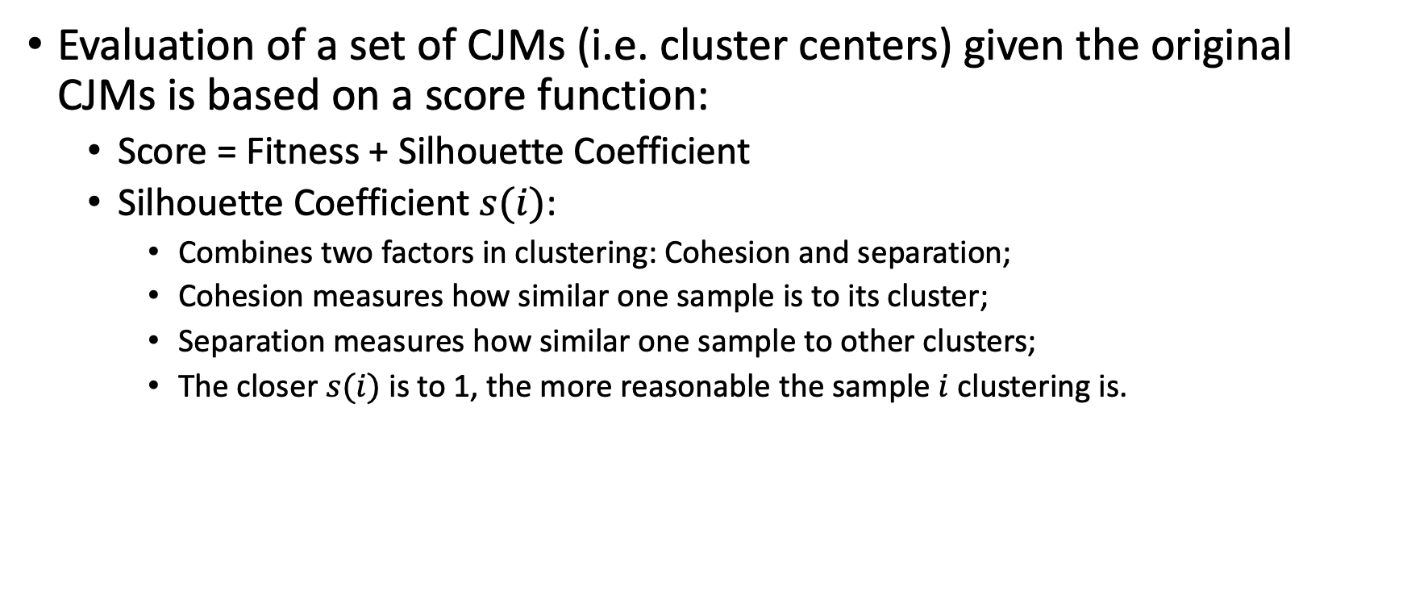
Evaluation Metric
Evaluation of a set of CJMs (i.e. cluster centers) given the original CJMs is based on a score function:
Score = Fitness + Silhouette Coefficient
Silhouette Coefficient $s(i)$:
Combines two factors in clustering: Cohesion and separation;
Cohesion measures how similar one sample is to its cluster;
Separation measures how similar one sample to other clusters;
The closer $s(i)$ is to 1, the more reasonable the sample $i$ clustering is.

Slide 6
Result

Slide 7
Notes

Slide 8
Result
func.data_sort_labmachine sorts all the final optimized CJMs within the destinated result folder and produces a CSV file with each column documents the best CJMs for that specific trial;
func.data_translate_labmachine translates the sorted file by two means:
Split a set of CJMs of one trial into individual CJMs
Translates the coded names for individual CJMs into named activities
The output of func. data_translate_labmachine is a CSV file where each row is a named cluster center specific to its trial number. Each trial can have multiple columns.

Slide 9
Result
What findings can we extract from the translated results:
Which set of centers appeared the most?
→ Where the algorithm is trapped the most?
Which set of centers received the highest score?
→ Closest to represent the journeys?
Which individual trip has the highest score?
→ Can suffer from accuracy issue due to lack of enough computation?
At different hours, which activities appeared the most?

